Slide 1

Vladyslav Shulianskyi

Slide 2
Genre: Arcade/Action Platformer

Slide 3
Game goals
Complete all levels
Collect the maximum number of points
Complete the level as quickly as possible

Slide 4
Points awarded
Level passing speed
Number of enemies killed
Number of collected bonuses
LiFes Spent

Slide 5

Gameplay

Slide 6









Helmets
Iron Knight
EyeClops
Red Stealth
Ram
Cyclone
Tank
Scycutter
Fly
MiniAxe

Slide 7
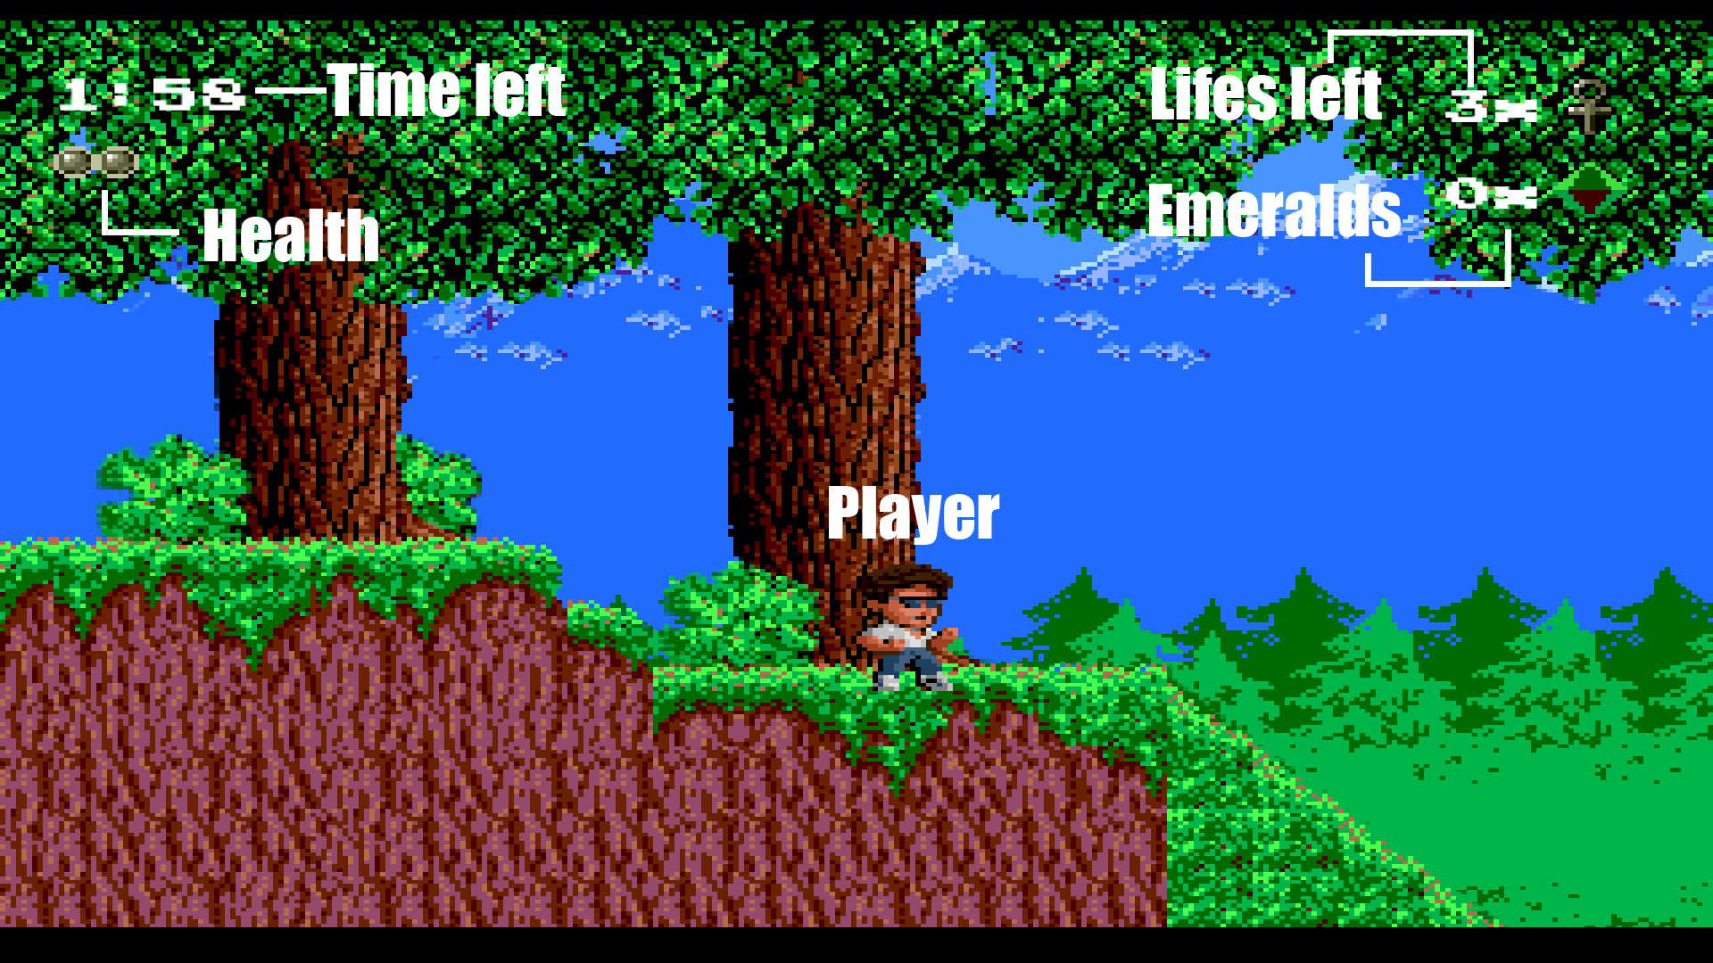
User Interface

Slide 8
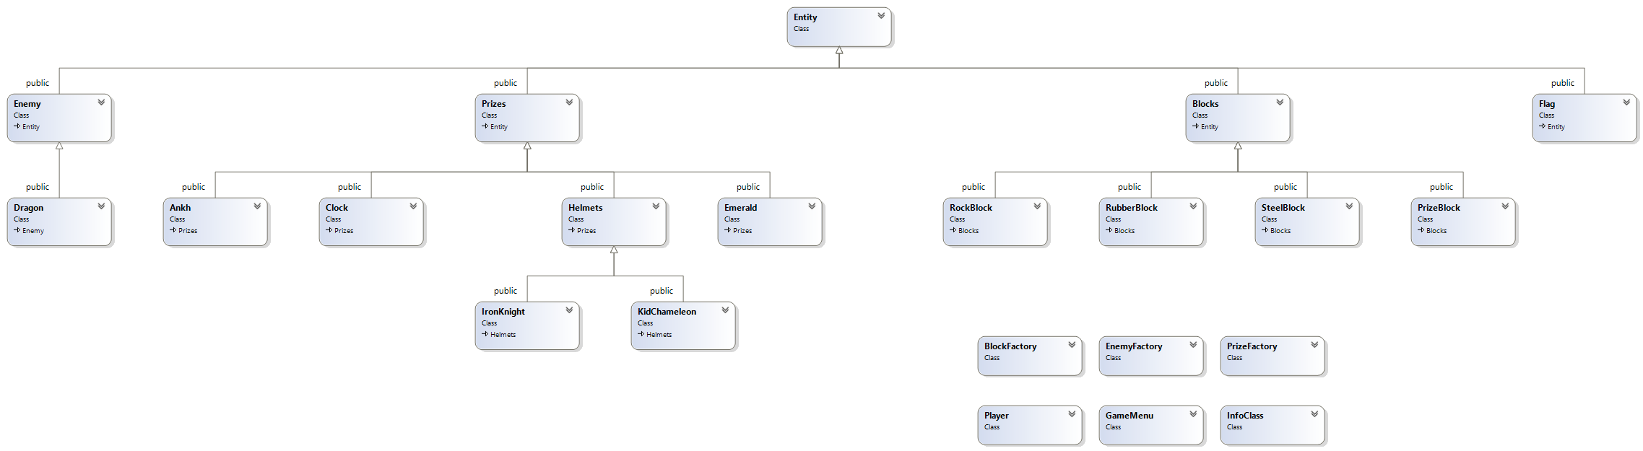
Class Diagram

Slide 9
Class Diagram

Slide 10
Patterns used
Adapter
Facade
Command
Factory

Slide 11



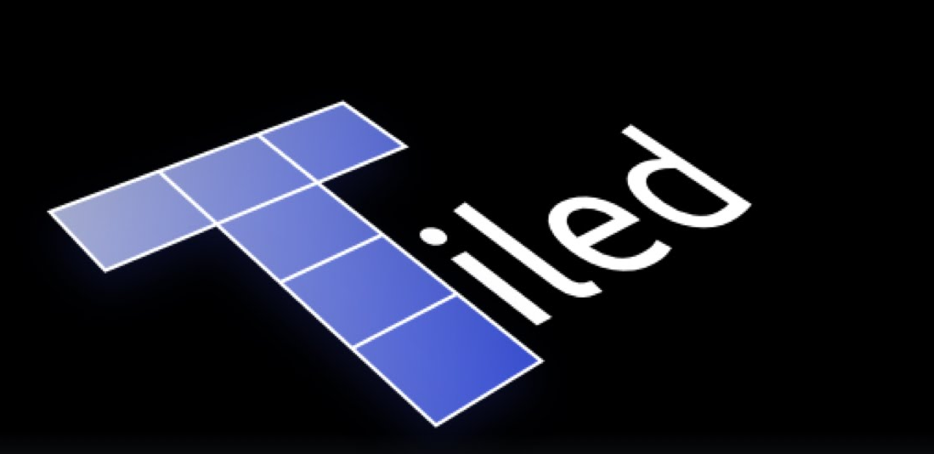

Technologies used

Slide 12
Demonstration

Slide 13
Questions

